Slide 1
GST Trends (Apr to July)
Month wise GST Revenue 2023-24 to 2026-27
(April to July) |  |  |  |  |  |  | (Rs. In crore)
Month | 2023-24 | 2024-25 | Growth over Previous year | 2025-26 | Growth over Previous year | 2026-27 | Growth over Previous year
April | 3778.89 | 3840.38 | 1.63% | 3661.53 | -4.66% | 4748.57 | 29.69%
May | 2936.26 | 3207.32 | 9.23% | 3491.04 | 8.85% | 3280.23 | -6.04%
June | 2820.33 | 3174.92 | 12.57% | 3453.33 | 8.77% | 3614.90 | 4.68%
July | 3123.77 | 3501.01 | 12.08% | 3809.67 | 8.82% | 4147.03 | 8.86%
Total | 12659.25 | 13723.63 | 8.41% | 14415.57 | 5.04% | 15790.73 | 9.54%

Slide 2
GST & VAT Revenue Apr to July
S.No. | Month | GST Net Revenue
 |  | FY 2025-26 | FY 2026-27 | Growth %
1 | April | (4646) 3,662 | 4,749 | (2.20%) 29.69%
2 | May | 3,491 | (3819) 3,280 | (9.39%) -6.04%*
3 | June | 3,453 | 3,615 | 4.68%
4 | July | 3,810 | 4,147 | 8.86%
Up to July |  | 14,416 | 15,790 | 9.54%
S.No. | Month | VAT Net Revenue
 |  | FY 2025-26 | FY 2026-27 | Growth %
1 | April | 1,795 | 2,008 | 11.85%
2 | May | 2,227 | 2,465 | 10.70%
3 | June | 2,215 | 2,487 | 12.30%
4 | July | 1,935 | 2,278 | 17.73%
Up to July |  | 8,172 | 9,238 | 13.04%
*538 Cr was deducted in the May’26, due to which growth has dropped to -6.04%, whereas it is actually 9.38%. Reasons being ascertained by TRU.

Slide 3
Revenue & Turnover Analysis Apr to July (2025 vs 2026)
Sector | Turnover (Apr-July'25) | Turnover (Apr-July'26) | Buoyancy % | Total Liability (I+C+S)'25 | Total Liability (I+C+S)'26 | Change % | Net Revenue to State'25 | Net Revenue to State’26 | Change %
All Sectors | 6,74,833.62 | 8,08,749.38 | 20% | 72,784.54 | 72,414.79 | -1% | 14,416 | 15,764 | +9.35%
Rate reduced after GST2.0
Vehicle/Automobile & Spare Parts | 31,834.99 | 37,641.53 | 18% | 7,830.42 | 6,431.08 | -18% | 1,994.50 | 1,966.20 | -1%
Electronic home appliance/ Solar devices | 45,314.41 | 58,666.66 | 29% | 7,377.23 | 7,275.19 | -1% | 1,561.26 | 1,474.01 | -6%
Machinery & Air Conditioning | 21,609.34 | 25,338.81 | 17% | 4,207.40 | 4,230.17 | 1% | 860.92 | 832.22 | -3%
Financial & Banking Services | 45,281.19 | 50,431.84 | 11% | 2,024.03 | 1,917.20 | -5% | 621.35 | 680.21 | 9%
Construction/Real Estate/ Cement | 59,583.98 | 58,993.72 | -1% | 11,025.37 | 9,248.03 | -16% | 1,844.03 | 1,426.45 | -23%
No Change in Rates
Iron and steel | 26,827.71 | 28,701.26 | 7% | 4,683.63 | 5,024.54 | 7% | 906.57 | 968.93 | 7%
Plastics and articles thereof | 11,913.42 | 15,408.86 | 29% | 2,093.29 | 2,552.13 | 22% | 411.41 | 480.29 | 17%
Mining and Manpower | 7,207.77 | 7,891.62 | 9% | 1091.3564 | 1184.60 | 9% | 392.59 | 425.88 | 8%
Articles of iron or steel | 6,145.57 | 8,553.79 | 39% | 1068.3116 | 1,460.64 | 37% | 281.38 | 364.61 | 30%
Rate Increased after 2.0
Fuel and Energy | 70,648.26 | 75,859.98 | 7% | 1,552.62 | 1,701.55 | 10% | 760.20 | 1078.48 | 42%

Slide 4
Key Observations (Apr–Jul 2026)
1
UNDERSTANDING THE IMPACT OF GST 2.0
AVERAGE EFFECTIVE TAX RATE
2
FY 2025–26
(Apr–Jul)
9.15%
FY 2026–27
(Apr–Jul)
8.22%
FY 2025–26
(Apr–Jul)
28%
FY 2026–27
(Apr–Jul)
18%
FY 2025–26
(Apr–Jul)
12%
FY 2026–27
(Apr–Jul)
5%
→
→
→
Reduction of ~11% in average effective tax rate
Expected reduction in tax liability approx. 36%
Expected reduction in tax liability approx. 58%
2
OVERALL REVENUE SUMMARY (APR–JUL)
TURNOVER
TOTAL TAX LIABILITY
NET REVENUE TO STATE
₹6.75 Lakh Cr
₹72,785 Cr
₹14,416 Cr
(Apr–Jul 2025)
(Apr–Jul 2025)
(Apr–Jul 2025)
▼
▼
▼
₹8.09 Lakh Cr
₹72,415 Cr
₹15,764 Cr
(Apr–Jul 2026)
(Apr–Jul 2026)
(Apr–Jul 2026)
+20%
-1%
+9.35%
3
KEY TAKEAWAYS
3
Despite the significant reduction in average effective tax rate from 9.15% to 8.22% due to GST 2.0, Rajasthan’s Tax liability has fallen by only 1% which was expected to fall by 11% based on effective tax rate. This year Net Revenue is increased by 9.35% whereas last year growth was 5.04%

Slide 5

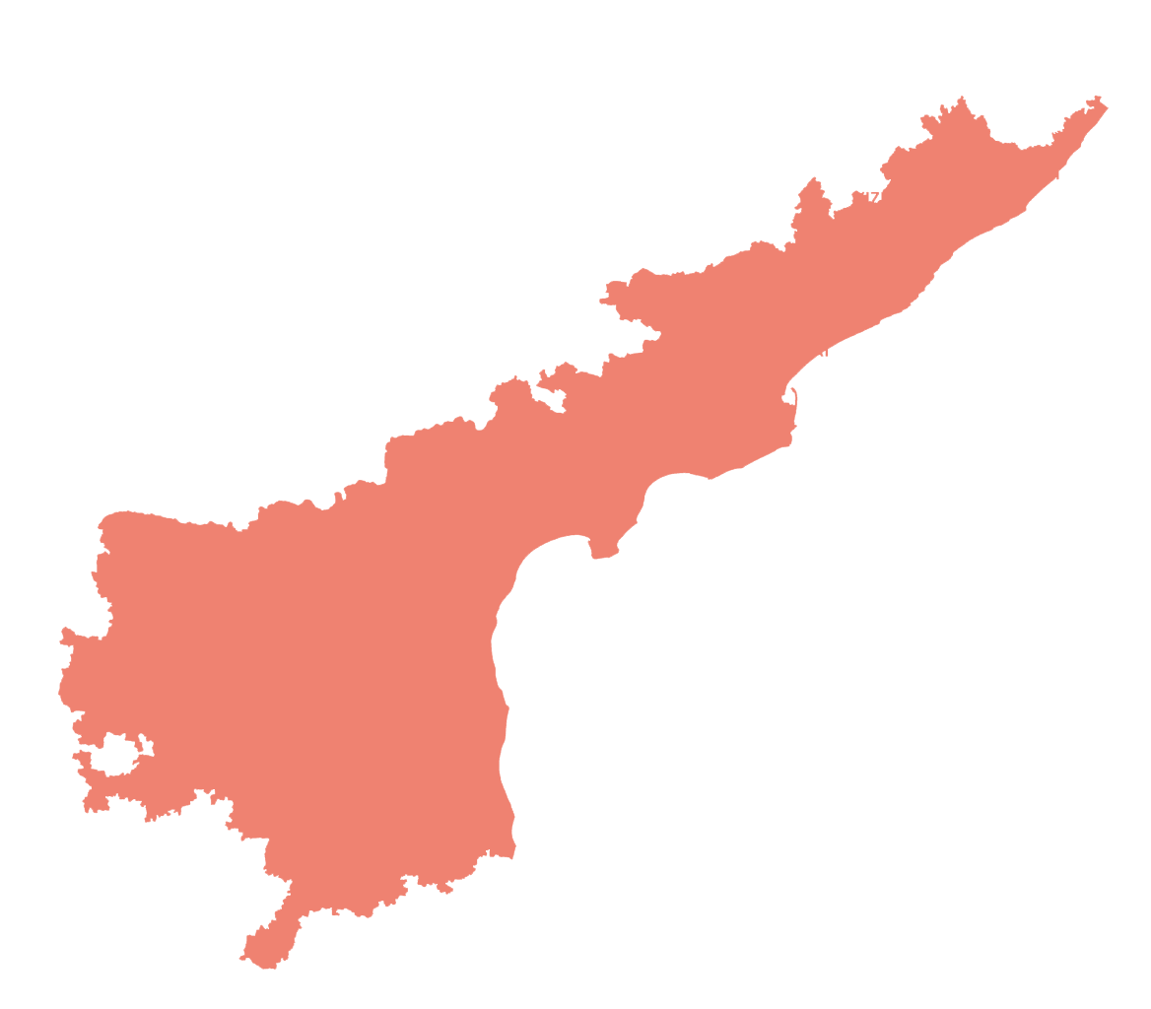
Directions of HCM Review
9th July 2026
DIRECTIONS
01
Visit & study best practices from AP & Gujarat
02
Prepare an action plan for their phase-wise implementation
PROGRESS
Visit to Andhra Pradesh done on 4th & 5th August 2026
Andhra Pradesh
Learnings from Gujarat - Detailed takeaways from the Gujarat study visit are consolidated on the following two slides
06 / 38
Notes:
Directions of HCM review, 9th July 2026: study best practices from AP and Gujarat.

Slide 6


Key Takeaways for Adaptation in Rajasthan
01
System of Review & Revision
02
Audit Planning & Case Selection
Dedicated Review Branch at head office
Risk-based selection & targets— orders dropping high-value Show Cause Notices, substantial refund orders, registration cancellations and cases of wilful misstatement or fraud
Targets fixed for each division: 85 cases per month and 1020 cases per year
Use of AI-Models to ascertain quality of appellate orders and assist in decision regarding further appeal
Centralized audit selection committee to finalize the annual audit plan
High-risk taxpayers profiled and taken up based on multiple risk parameters
Sector-focused, thematic and emerging-risk audits, with repeat audit where prior-year recovery was substantial and risk parameters persist
Outcome uniform, quality orders · reduced litigation · timely appeal and revision of orders affecting Govt. revenue
Outcome higher recovery per audit and better deployment of limited officer strength

Slide 7


Key Takeaways for Adaptation in Rajasthan
03
Registration Control & Bank account verification
04
Enforcement
PAN-based search at the time of registration to minimize already-cancelled firms obtaining fresh registration
Close monitoring of every new registration during the first 6 months of operation to prevent misuse of ITC
Continuous non-filer monitoring, with identification of dormant and suspicious taxpayers for follow-up action
Single risk profile for each taxpayer built from returns, e-way bill movement, registration history and third-party data
Early-bird predictive detection on e-way bill data — commodity wise, location wise analysis of supply and purchase (for example, consignments originating from North-Eastern States)
Secret contingency fund provided every year for raid, checking and field operations, and developing own intelligence
Outcome preventive control at source — bogus firms stopped before ITC leakage begins
Outcome Preventing establishment of fake firm networks and targeted enforcement actions

Slide 8
Enforcement
DIRECTIONS
DIRECTIONS
- Take state-wide action against ITC fraud and fake networks.
- Use intelligence-based decoy operations in high-risk sectors.
- Sector-wise calendar based on festivals etc., for anti-evasion action.
Progress
Particulars | Completed FY25–26 | Up to June’26 | July’26 | FY 26-27 Overall
No. of cases | 638 | 221 | 121 | 312
Revenue Leakage Detected | - | 310 Cr. | 216 Cr. | 526 Cr.
Voluntary Payments | 459 Cr | 185.38 Cr | 59.16 Cr | 244.54 Cr
Notes:
Enforcement directions and progress on anti-evasion activities, FY2026-27.

Slide 9
Decoy Operations in July 2026
Parameter | Details
Sector Covered | Coaching Institutes
Operations Conducted | 8 decoy operations across multiple districts of Rajasthan Path Career Institute, Sikar Prayas Coaching Institute, Sikar DS Science Institute, Gangapur City
Modus Operandi Identified | • Suppression of taxable turnover by Non-issuance of tax invoices and Cash collections kept outside GST records • Incorrect / Excess ITC claim
Revenue Identified | ₹ 9.2 Crore
Voluntary Tax Payment | ₹ 1.4 Crore
Current Status | Investigations initiated and further verification in progress

Slide 10
Decoy Operations in July 2026
Parameter | Details
Sector Covered | Retail shops
Operations Conducted | Baba Thakur Das & Sons (Sweets Shop)
Modus Operandi Identified | The case was detected by departmental officers when it was found that the dealer was making outward supplies without issuing invoices and collecting payments through UPI/QR codes linked to personal and employees' bank accounts. 15 QR codes were identified.
Revenue Identified | ₹ 2 Crore detected so far (13 QR Codes more to analyzed)
Voluntary Tax Payment | -
Current Status | Investigations initiated and further verification in progress

Slide 11














Further plans in FY 2026-27
Operations Planned
MARBLE & GRANITE
AGRO PRODUCTS
RESTAURANTS & HOTELS
HOSPITALS
PHARMACIES
Tax evasion through undervaluation, cash sales & bogus transactions
Misuse of exemptions, suppression of turnover & input tax credit irregularities
Cash transactions, suppression of turnover & ITC misuse
Incorrect classification, exempt vs taxable supplies & ITC irregularities
Purchase vs sales mismatch, expired stock, ITC misuse & non-compliance
FESTIVAL / EVENT
SUGGESTED COMPLIANCE OPERATION
Verify gift dealers and sweet shops for unusual sales spikes
E-Way Bill monitoring for stock movement
B2C invoice & cash sales verification
Rakhi Season
(Aug)
Focus on fireworks, electronics, jewellery, gifting items, dry fruits, decorations & temporary traders
Monitor cash-intensive businesses and stock movement
E-Way Bill verification
ITC availed vs outward supplies
Diwali
(Nov)
Temporary stalls, pandal contractors, event management
Decoration suppliers & food stalls
E-Way Bill & turnover verification
ITC availed vs business profile
Durga Puja /
Navratri
(Oct)
Hotels, resorts, travel agencies, Airbnb, cab operators
Occupancy vs GST turnover analysis
Monitor online bookings & aggregator data
Transport (cab, taxi, tour operators) compliance
Tourism Season
(Dec – Feb)
Banquet halls, caterers, decorators, tent houses
Photographers, jewellery & event planners
Identify under-reporting of B2C supplies
ITC utilization & cash transaction check
Wedding Season
(Dec – Feb)

Slide 12
Inter-Departmental Data & AI Analytics
DIRECTIONS
Identify tax evasion using inter-departmental data sources.
Identify tax evasion using AI & risk-based analytics.
Particulars | Status
No. of Depts from whom data is received | 5
No. of Depts from whom data is requested | 5
No. of use cases developed | 8
Revenue Potential detected | Approx. 100 Cr.

Slide 13
Inter-departmental data sources
#. | Dept | Departmental Data Taken | Use Cases based on data | No. of Cases & Revenue potential | Integration Status
1 | Electricity (DISCOM) | Electricity Consumption Data for 1 year | High Turnover low Consumption Low Turnover High Consumption Domestic Connection but High Turnover | 238 Cases | Complete
2. | IGRS | Joint Development Agreement, Rent Agreements | 1. Rent Agreement vs GST RCM Paid | 124 Cases; Potential: 18 Cr. | Complete
3 | Mining | eRawanna, Transit Pass, ERCC contracts | 1. ERCC royalty discrepancy 2. Royalty paid vs RCM paid in GST | 3198 Cases; Potential: 50 Cr. | Data Dump Received; Use Cases Developed
4 | RERA | Property sold, Project detail | Units Sold vs GST Turnover ITC reversal due to Completion Certificate | 271 Cases; Potential: 30 Cr. | Data Dump Received; Use Cases Developed
5 | RGHS | Payments and Invoices details for Hospitals and Pharmacies | Cancelled Taxpayer Invoices Turnover Mismatch | 238 Cases; Potential: 5 Cr. | Sample Data Received; Use Cases Developed

Slide 14
Example: Health Care Sector (RGHS vs GST Data Analysis)
As per the preliminary analysis of Pharmacy and Hospitals data shared by RGHS, 2 major use cases have been detected on comparing the GST Returns data with the invoice data:
1
USE CASE 1
2
USE CASE 2
Cancelled GSTIN, invoices Still Issued
Suppression of turnover
GST registration cancelled, yet RGHS continued deducting TDS against the same GSTIN.
Amount deducted by RGHS is more than the total turnover shown in GST returns.
TAXPAYERS
MISMATCH
TAXPAYERS
MISMATCH
13
₹1.30 Cr
225
₹29.14 Cr
TOTAL ACROSS ALL USE CASES
238
Total Turnover Mismatch
₹30.44 Cr

Slide 15
Inter-departmental data sources
#. | Dept | Integration Task | Current Status | Integration Status
1 | Transport | Vehicle Owner Detail (Vehicle Registration Data) | API requested from MoRTH and Transport Dept.. | In Progress
2. | JDA | Invoice wise detail of payment done against the contracts | Sample Data Shared by JDA, API is being developed at their end. | In Progress
3 | IFMS | Invoice wise detail of payment done against the vendors | Discussion done. API is being developed at their end. | In Progress
4 | Railways | Weight of Goods, Value of Goods etc. | Data feasibility study under progress. | In Progress
5 | UDH | Auction processing fees, Lease of land , Sales of commercial plots , Licensing fees | Data feasibility study under progress. | In Progress
6 | Electricity (DISCOM) | We need read only data access to fetch details using tradenames/ legal name/ mobile | We are only able to fetch details using K-Number which is not available for all the taxpayers. | In Progress

Slide 16
AI – ML & Risk Based Analytics (1/3)
1
USE CASE 1
2
USE CASE 2
3
USE CASE 3
New Registration High Inter-State Sales
Non-Filers more than 6 months
Electricity Consumption Compared with GST Turnover
Newly registered taxpayers having inter-state sales and tax paid entirely using ITC
Taxpayers who have not filed return for than 6 month, either made to file returns or suspended / cancelled if found inexistent / non-genuine.
The electricity bill of the taxpayers were read using OCR and electricity consumption was compared with the Turnover of the Manufacturer Taxpayers
TAXPAYERS
Amount Involved
TAXPAYERS
Cancelled / suspended
TAXPAYERS
Domestic Connection but Turnover>10 Cr
51
₹296 Cr
2950
436
238
215

Slide 17
AI – ML & Risk Based Analytics (2/3)
4
5
USE CASE 5
6
USE CASE 6
USE CASE 4
Taxpayers having Bank Accounts involved in Cyber Frauds
Same Bank Account used by multiple GSTINs which was cancelled previously
Active Registration in Rajasthan but rejected in other states
The Bank Accounts provided in the GST Registration was compared with Bank Accounts involved in Cyber Fraud
Same bank account linked to multiple taxpayers. Out of these taxpayers more than 50% are cancelled.
Taxpayer’s whose registration application was rejected / Cancelled in other states but is doing business in Rajasthan
TAXPAYERS
Cancelled / suspended
TAXPAYERS
Cancelled / suspended
TAXPAYERS
356
30
3474
159
1607
238

Slide 18
AI – ML & Risk Based Analytics (3/3)
7
8
USE CASE 8
9
USE CASE 9
USE CASE 7
NIL Filers for more than 12 months
GST welcome letter not delivered
OCR Based reading of documents
Taxpayers filing Nil returns regularly which means no active business, but may be sleeping cells which may pass on fake ITC in upcoming returns
Welcome Letters are sent by GSTNto all newly registered taxpayers to ensure the place of business. Returned welcome letter may lead to suspicious taxpayers
Extraction and analysis of data from GSTR-9, Profit & Loss Statements, Balance Sheets etc. using OCR and comparison with GST Database.
Eg. Legal fees paid as per P&L but RCM not paid in GST
TAXPAYERS
Taxpayer suspended
TAXPAYERS
Taxpayer suspended
1.02L
27274
20730
1267
Work in Progress

Slide 19
Fake Firm Detection & Cleaning the Taxpayer Base
FAKE FIRM DETECTION
CLEANING THE TAXPAYER BASE
Particulars | FY25–26 | FY26-27
Fake Firms Detected | 330+ | 63
ITC Involved (₹ Cr) | 668.41 | 259.71
Suspicious Firms (Repeat Offenders) | - | 3474
Registration Cancelled (Improper Docs / Field Visit) | - | 5032
Particulars | FY25–26 | FY26-27
Potentially Suspicious Taxpayers from Nil Payers | - | 27274*
Returned Welcome Letters |  | 1267
FY25–26
Particulars
FY25–26
FY26–27
*Identified through nil-filing pattern analysis; further field verification in progress.
19 / 38
Notes:
Fake firm detection and revenue from intelligence reports; cleaning the taxpayer base.

Slide 20
Tax Administration Performance Index Source : GST Analytics and Intelligence Network portal - GSTN
Composite score across 16 GST administration parameters, by state (Published Quarterly)
State Rankings — Total Score (0–100)
PAN INDIA avg: 52.4

Slide 21
Revenue Growth: Month-wise Forecasting Snapshot
FY 2026–27 ( ₹ in Crore )
Month | FY-26-27 | Growth
Apr | 4,749 | 2.21%
May | 3,280 | -6.39%
Jun | 3,615 | 4.68%
Jul | 4,147 | 8.86%
Aug | 3,865 | 8.10%
Sep | 3,735 | 8.95%
Oct | 4,695 | 12.81%
Nov | 4,395 | 13.04%
Dec | 3,851 | 13.46%
Jan | 4,590 | 14.61%
Feb | 4,134 | 10.56%
Mar | 4,985 | 12.12%
Total | 50,014 | 8.61%
Aug 26 – Mar’ 27 figures are model-based forecasts – XGBoost, Time Series, Arima
Full-year GST net revenue is projected to grow by 8.61 %, increasing from ₹46,050 Cr (FY25–26) to ₹ 50014 Cr (FY26–27).

Slide 22
Meeting with Secretary Revenue, GOI
Meeting with Secretary Revenue, GOI
Point 1 : The note mentions that Rajasthan's B2C ratio is approximately 7, against a normal benchmark ratio of 4.5.
GSTN was requested for complete data and methodology. GSTN report is as given below:
ALL INDIA (in 1 Lakh Crore)
FY | B2C Supply | Domestic Supply | B2C%
2017-2018 | 32.03 | 168.32 | 19.03%
2018-2019 | 48.64 | 260.85 | 18.65%
2019-2020 | 49.57 | 261.52 | 18.95%
2020-2021 | 46.77 | 261.06 | 17.91%
2021-2022 | 58.34 | 344.33 | 16.94%
2022-2023 | 69.44 | 407.16 | 17.06%
2023-2024 | 76.38 | 444.22 | 17.19%
2024-2025 | 82.65 | 495.14 | 16.69%
2025-2026 | 91.56 | 567.44 | 16.14%
Grand Total | 555.39 | 3210.03 | 17.30%
Ratio |  |  | 5.78
RAJASTHAN (in 1 Lakh Crore)
FY | B2C Supply | Domestic Supply | B2C%
2017-2018 | 1.30 | 6.84 | 19.00%
2018-2019 | 1.96 | 10.53 | 18.59%
2019-2020 | 2.00 | 10.52 | 19.04%
2020-2021 | 1.97 | 10.86 | 18.16%
2021-2022 | 2.51 | 14.42 | 17.38%
2022-2023 | 2.94 | 16.84 | 17.49%
2023-2024 | 3.22 | 18.11 | 17.80%
2024-2025 | 3.48 | 19.96 | 17.42%
2025-2026 | 3.85 | 22.51 | 17.10%
Grand Total | 23.23 | 130.58 | 17.79%
Ratio |  |  | 5.62
Conclusion — Based on the data provided by GSTN, no significant difference is observed between Rajasthan’s B2C ratio (5.62) and the all-India ratio (5.78).

Slide 23
Meeting with Secretary Revenue, GOI
Point 2:
An anomaly-detection technique identified approximately 5.37 lakh taxpayers who paid lower tax compared to their respective peer band.
De-duplicated Taxpayers – 2.70 L
Liability <= 1Lakh (Paid by ITC) – 1.62 L
To be analyzed – 1.08 L
Point 3:
Approximately 1.22 lakh taxpayers paid only ₹194 crore through the cash ledger.
DATA NOT RECEIVED
Notes:
Point 2: anomaly-detected taxpayers paying lower tax vs peer band; current status.

Slide 24
Other Departmental Progress: Scrutiny, Recovery & Audit
Particulars | FY25-26 (Apr – July) | FY26-27 (Apr – July)
Cases Taken Up for Scrutiny | 25,225 | 34,401
Revenue Recovery (Overall), Cr. | 129.91 | 150.25
Audit | FY25-26 |  | FY26-27
 | Cases Disposed | Revenue Realized | Cases Disposed | Revenue Realized
April | 54 | 2.76 | 153 | 5.67
May | 176 | 6.10 | 244 | 9.03
June | 179 | 7.44 | 267 | 7.98
July | 119 | 5.58 | 145 | 13.81
Total | 528 | 21.87 | 809 | 36.49
Cases selected based on high-risk parameters and large taxpayers (above ₹10 Cr).
34 / 38
Notes:
Scrutiny and recovery directions and progress, including faceless scrutiny implementation.

Slide 25
Litigations
PERMISSION FOR PANEL LAWYERS PENDING FOR:
Revenue Board
GSTAT
NCLAT
PERMISSION FOR PANEL LAWYERS RECEIVED FOR:
CSTAA
CESTAT
NCLT
Forum | Pending Cases
Supreme Court | 421
Rajasthan High Court — Jodhpur (Principal Seat) | 535
Rajasthan High Court — Jaipur Bench | 1609
RCSAT Court | 19
Other State High Courts | 5
Economic Offences Court | 23
Tax Board & Revenue Board | 330
GSTAT | 182
NCLT + NCLAT + CSTAA + CESTAT + Others | 74
Total | 3195
Additional Commissioners handling cases as the 1st Appellate Authorities | 15399
Notes:
Litigation status: panel lawyer permissions and cases pending across forums.

Slide 26
THANK YOU

Slide 27
HPCL RAJASTHAN REFINERY LIMITED
Note on Estimated State Revenue — FY 2026-27
PRINCIPAL ASSUMPTIONS
Levy-wise estimated and actual revenue accruing to the State of Rajasthan (₹ in Crore)
Inter-State sales: CST computed @ 2% against Form ‘C’. Intra-State despatch ratio taken at 28% (MS) and 37% (HSD); balance inter-State.
SGST: computed @ 9% on Kerosene, Sulphur, Petroleum Coke and Naphtha, and @ 2.5% on LPG.
RVAT: taken as Nil for Aug-26 to Mar-27 as per VAT exemption to HRRL vide notification dated 17-07-2026. Jul-26 actual RVAT of ₹46.17 Cr reported on HSD.
Planned production for Aug-26 to Mar-27 is estimated at approximately 70% of capacity.
Levy | Product | Aug-26 to Mar-27 (Estimated) | Jul-26 (Actual) | Total FY 2026-27
SGST | All GST products | 152.37 | 0.81 | 153.18
RVAT | MS (Petrol) | – | – | –
RVAT Cess | MS (Petrol) | 42.90 | 0.04 | 42.94
CST @ 2% | MS (Petrol) | 95.78 | – | 95.78
RVAT | HSD (Diesel) | – | 46.17 | 46.17
RVAT Cess | HSD (Diesel) | 184.32 | 6.73 | 191.05
CST @ 2% | HSD (Diesel) | 241.18 | 0.01 | 241.20
Total |  | 716.55 | 53.77 | 770.32
Levy rate context (per VAT/GST Revenue Report): Petrol and Diesel VAT rates of 29.04% and 17.30% respectively (applicable till 16-07-2026) stand exempted for the period 17-07-2026 to 31-03-2027, under the terms and conditions of the exemption notification.
Qualification: Figures for Aug-26 to Mar-27 are estimates for the limited purpose of indicating likely State revenue; actuals will depend on refinery throughput, product slate, product prices, despatch pattern and levy rates in force. Statutory returns as filed from time to time shall prevail.
References: (1) HRRL Note on Estimated State Revenue, HPCL Rajasthan Refinery Limited • (2) HRRL VAT/GST Revenue Report, July 2026

